Slide 1
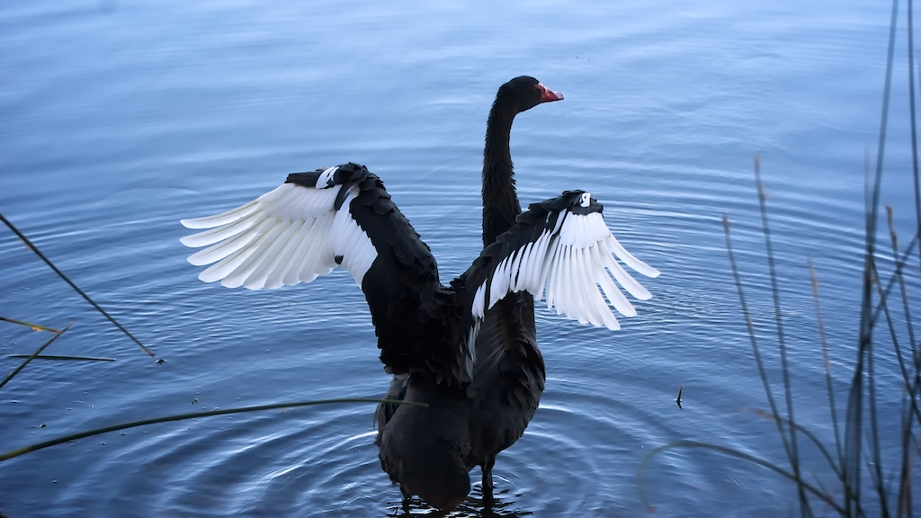
THE NOONGAR SEASONS
We will explain the Noongar seasons using movements of the Earth

Slide 2
True or False?
Earth is the only object in space that rotates.
The moon rotates slower than Earth.
There are 8 planets in our solar system.
Earth is the only planet with a moon.
The current model of the solar system is geocentric.
One orbit is called a revolution.

Slide 3
Repeat the opposite word/phrase.
ORBIT
PATH AROUND AN OBJECT

Slide 4
Repeat the opposite word/phrase.
SATELLITE
NATURAL BODY CIRCLING A PLANET

Slide 5
Repeat the opposite word/phrase.
AXIS
LINE OF ROTATION

Slide 6
Repeat the opposite word/phrase.
ROTATION
SPIN ON AXIS

Slide 7
Repeat the opposite word/phrase.
REVOLUTION
SINGLE ORBIT

Slide 8
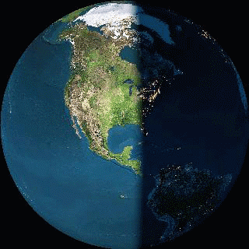
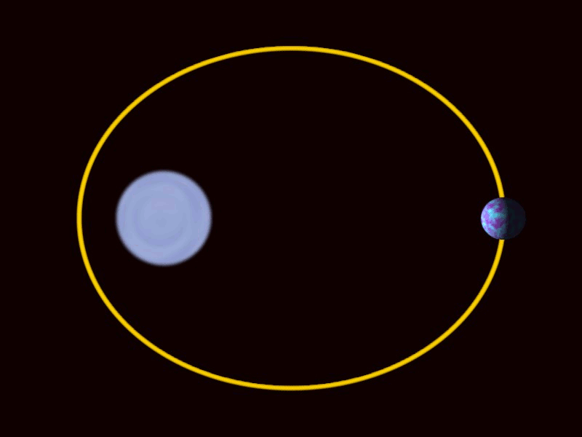
Which of the diagrams show a rotation?
Which of the diagrams show a revolution?
A B

Slide 9
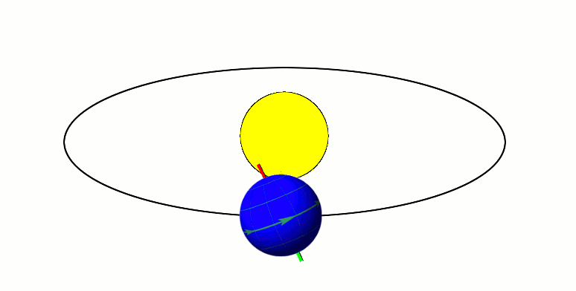
Draw a diagram showing the southern hemisphere experiencing winter.
Sept
Dec Jun
Mar

Slide 10
We will explain the Noongar seasons using movements of the Earth
TRACK WITH ME
READ WITH ME
We will describe the Noongar seasons
We will model the Earth’s movements during the Noongar seasons
DECLARE THE OBJECTIVE
Read the learning objective to your partner.
Notes:
Learning Objectives contain concepts (nouns, big ideas), skills (verbs, measurable behaviours) and sometimes context (restricting or targeting conditions).
●Example: Students will be able to describe the concept of density and apply it to floating and sinking.
●
Success criteria are specific measurable outcomes that if met mean that the student has met the learning objective.
Examples:
•Students will be able to compare densities of substances using mass and volume.
•Students will be able to identify whether a solid or liquid will float or sink in a liquid based on their densities.

Slide 11

We will explain the Noongar seasons using movements of the Earth
When we are experiencing summer, is it summer in the rest of the world?
Does everywhere else get as hot as here in summer?
MAKE THE CONNECTION
Students, you already know that we experience different seasons throughout the year.

Slide 12
We will explain the Noongar seasons using movements of the Earth
When we are experiencing summer, is it summer in the rest of the world?
Does everywhere else get as hot as here in summer?
Seasons can be different depending on where you are on Earth!
MAKE THE CONNECTION
Students, you already know that we experience different seasons throughout the year.

Slide 13
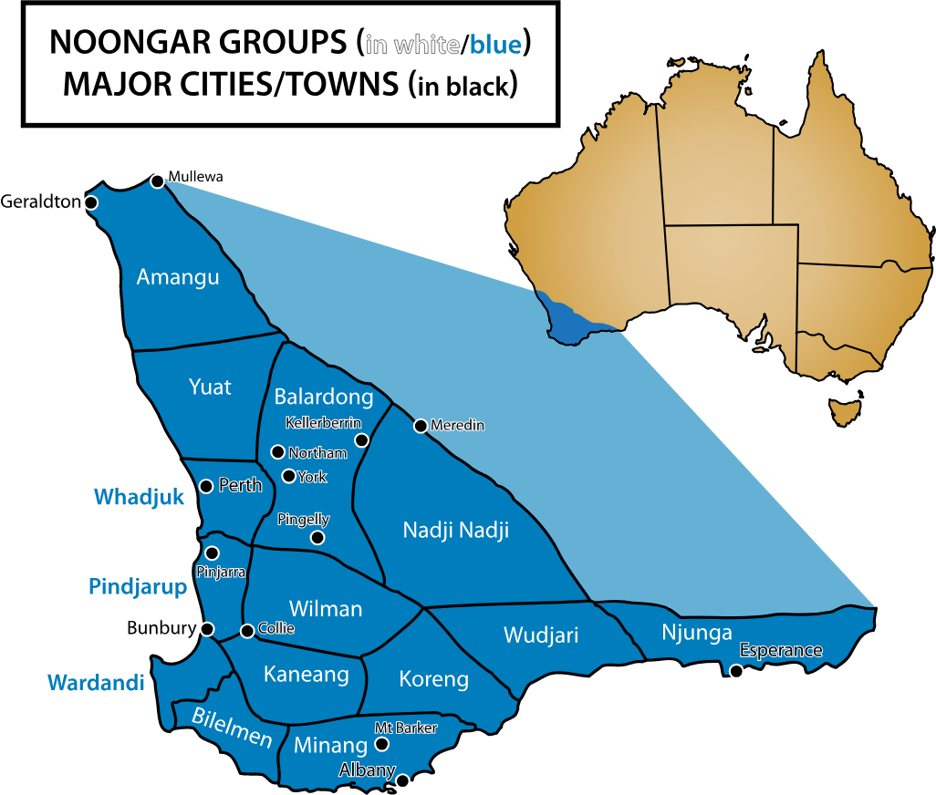
We will explain the Noongar seasons using movements of the Earth
The Noongar people have lived in the south-west of Western Australia for over 45,000 years.
In Noongar country there are 14 different areas with 14 different language groups.
CHECK FOR UNDERSTANDING
Looking at the map, which area is Perth located in?

Slide 14
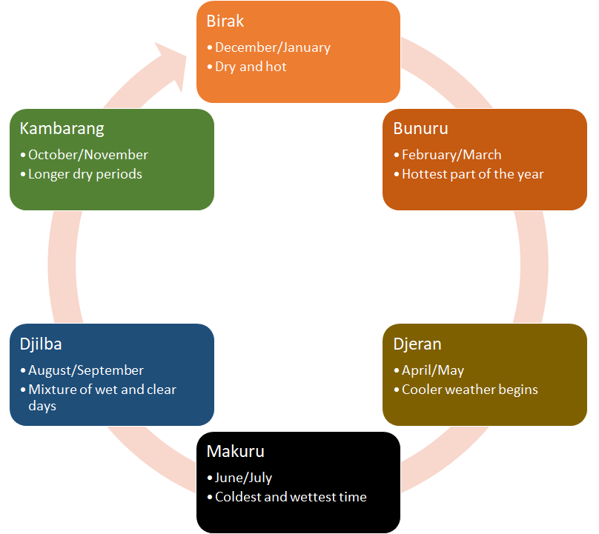
We will explain the Noongar seasons using movements of the Earth
The Noongar calendar has six seasons.
Noongar people have traditionally hunted and gathered food according to the six seasons.
Each season is described by changes in flora₁/fauna₂ and changes in the weather.
CHECK FOR UNDERSTANDING
Which Noongar season are we in right now?
VOCABULARY
1 - plants 2 - animals

Slide 15
We will explain the Noongar seasons using movements of the Earth
Birak - The First Summer
Season of the Young
Reptiles emerge from hibernation
Performed controlled burns
Hunted kangaroo and wallaby
CHECK FOR UNDERSTANDING
Draw this diagram on your whiteboard with the names of the six seasons.

Slide 16
We will explain the Noongar seasons using movements of the Earth
Bunuru - The Second Summer
Season of Adolescence
Children learn the art of tool-making
Families camped near coast and river inlets to fish
CHECK FOR UNDERSTANDING
Add what the weather is like to your diagram.

Slide 17
We will explain the Noongar seasons using movements of the Earth
Djeran - The Autumn
Season of Adulthood
Time of marriages and courtship ceremonies
Families moved further inland along Swan River to continue to fish. They also collected buds and seeds to eat.
CHECK FOR UNDERSTANDING
Which Noongar season you were born in?

Slide 18
We will explain the Noongar seasons using movements of the Earth
Makuru -The First Rains
Fertility Season
Time to travel to inland hunting areas to hunt swans and grubs
Built mia mia (huts) for shelter and wore booka (kangaroo skin coats)
CHECK FOR UNDERSTANDING
Which Noongar season is New Years Eve within?
Notes:
Mia mia is pronounced mya mya

Slide 19
We will explain the Noongar seasons using movements of the Earth
Djilba - The Second Rains
Season of Conception
Rains fill lakes and waterholes
Hunted emu, kangaroo, bandicoot, and possum
Dug up native potatoes from beneath wandoo trees
CHECK FOR UNDERSTANDING
Makuru is similar to one of the four seasons we spoke about last lesson. Which do you think it is?

Slide 20
We will explain the Noongar seasons using movements of the Earth
Kambarang - The Wildflower Season
Season of Birth
Carpets of wildflowers
Families move back toward the coast to collect eggs and hunt birds, frogs, crayfish and tortoise
CHECK FOR UNDERSTANDING
Kambarang is similar to one of the four seasons we spoke about last lesson. Which do you think it is?

Slide 21
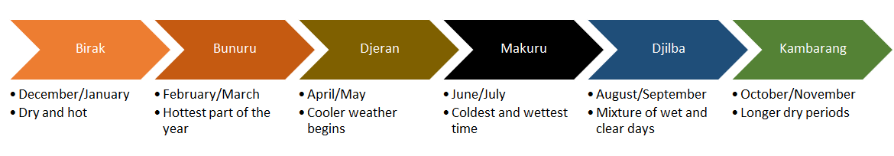
We will explain the Noongar seasons using movements of the Earth
The Noongar seasons can be explained using the movements of the Earth.
Oct/Nov
Aug/Sep
Dec/Jan
Jun/Jul
Birak
Feb/Mar
Apr/May

Slide 22
We will explain the Noongar seasons using movements of the Earth
Draw a diagram showing Birak using the sun and the Earth.
Draw a diagram showing Makuru using the sun and the Earth.
Oct/Nov
Aug/Sep
Dec/Jan
Jun/Jul
Feb/Mar
Apr/May

Slide 23

We will explain the Noongar seasons using movements of the Earth
Learning the Noongar seasons helps us understand the seasons we experience specifically in Perth and south-west of Western Australia.
Winter, summer, autumn and spring can be different all over the world!
CHECK FOR UNDERSTANDING
Why are there six Noongar seasons?

Slide 24
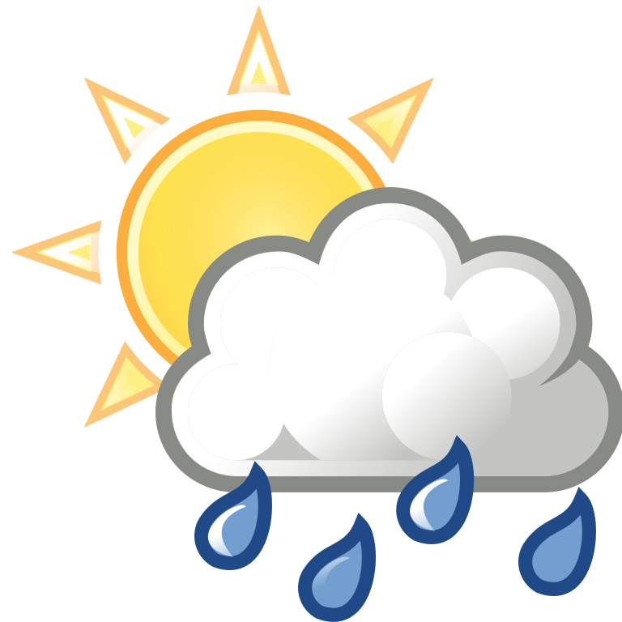
We will explain the Noongar seasons using movements of the Earth
There are six Noongar seasons:
Birak
Bunuru
Djeran
Makuru
Djilba
Kambarang
They can be explained by the movements of the Earth, just like summer, winter, autumn and spring.

Slide 25
We will explain the Noongar seasons using movements of the Earth
Draw a diagram of the Earth’s movements around the sun and label the Noongar seasons.
Create a Noongar seasons spinner.
REMEMBER THE CONCEPT
Remember that the seasons can be explained using the movements of the Earth around the sun.
Notes:
Please include tasks/questions here rather than just referring to a worksheet. This will save on photocopying and facilitate sharing with other schools.
Try and build tasks/questions which escalate through Bloom’s Taxonomy. This will help with differentiation.

Slide 26
We will explain the Noongar seasons using movements of the Earth
We will describe the Noongar seasons
We will model the Earth’s movements during the Noongar seasons
CHECK FOR UNDERSTANDING
Check Success Criteria.

